Slide 1
Persistance Of Vision: LED Globe
Jordi Jaspers

Slide 2
Summary
Introduction
Parts List
Build of the structure
Electrical schematics
Block Diagram
Actual Verilog code
Demonstration

Slide 3
Introduction
POV = Persistance Of Vision
“”The optical illusion that occurs when visual perception of an object does not cease for some time after the rays of light proceeding from it have ceased to enter the eye.”

Slide 4
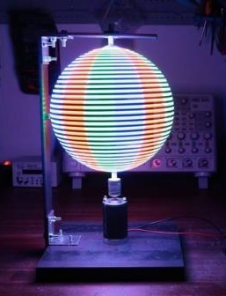
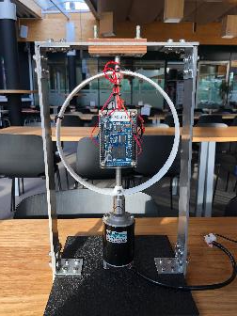

Introduction
Applying this principle to a rotating circle, You’ll get a globe.

Slide 5
Parts List
1x DE0 FPGA NANO
1 x WS2812b LED Strip
1x 3144A Hall effect sensor
1x LiPo Battery (1200mAh)
1x TP4056 Protect/Charge circuit
1x Boost Converter
1x Ball Bearing
1x 12V 3000RPM DC Motor
1x 8mm Adapter
1x 200x200x20mm Steel base plate
3x 40x500x4mm flat steel
M4, M5 bolts & nuts
8mm aluminum rod

Slide 6
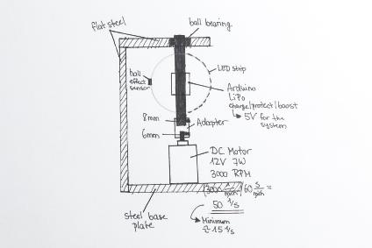
Build of the structure
Step 1: Creating an overall plan of the structure.
Step 2: Cutting the plates to the right size.
Step 3: Marking and drilling all the necessary holes.
Step 4: Cleaning and painting the metal parts to prevent rust.

Slide 7
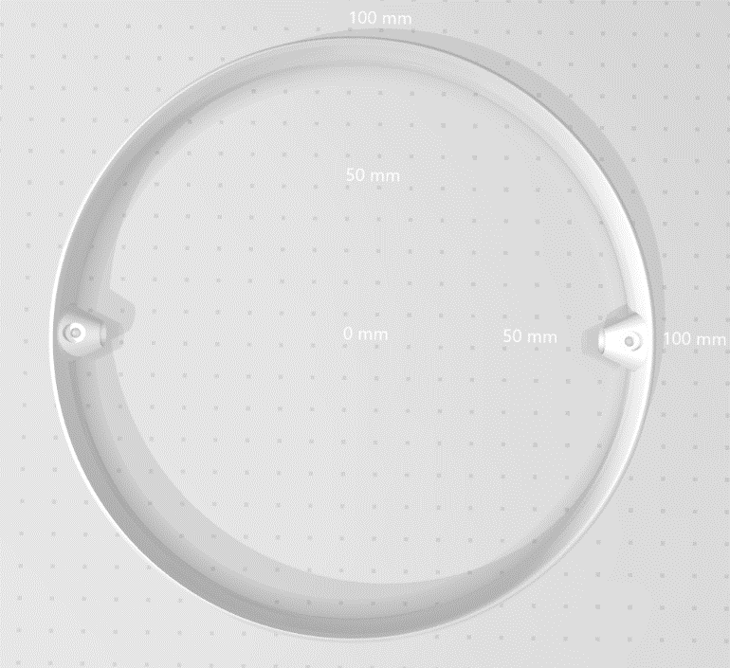
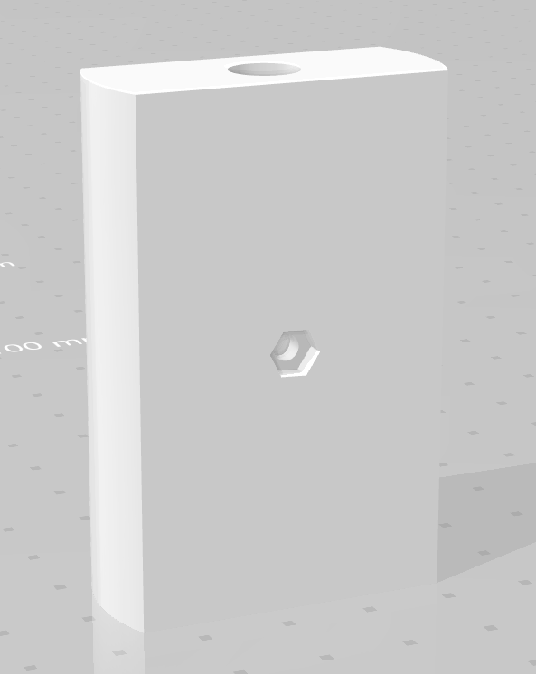
Build Of The Structure
Step 5: Drawing the 3D-printed parts.
Step 6: Mounting all the parts together.
Step 7: Look for stability flaws.
Step 8: Fine-tune the whole structure.

Slide 8
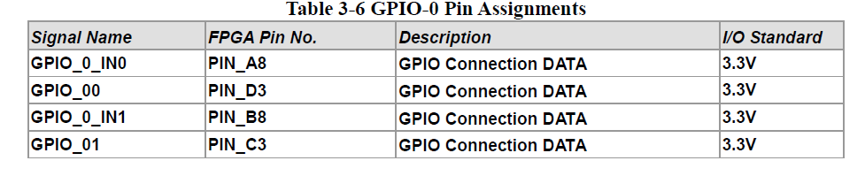
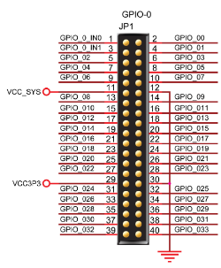
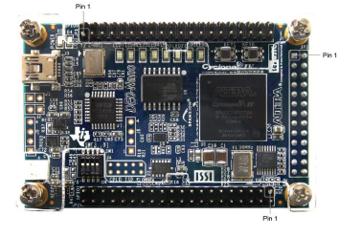
Electrical Schematics
Before drawing the electrical schematics, research about the FPGA is REQUIRED.

Slide 9
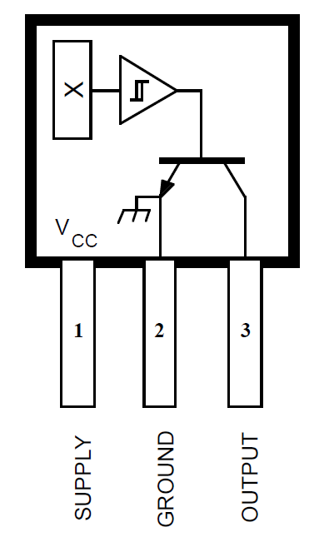
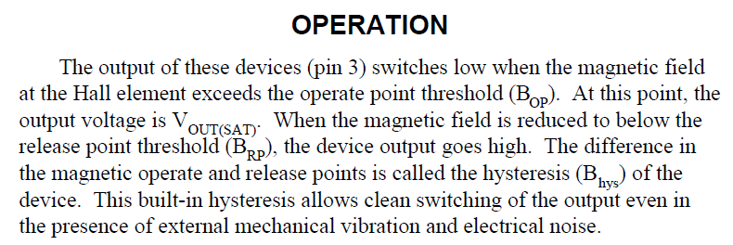
Electrical Schematics
Looking up the datasheet of the Hall-sensor.

Slide 10
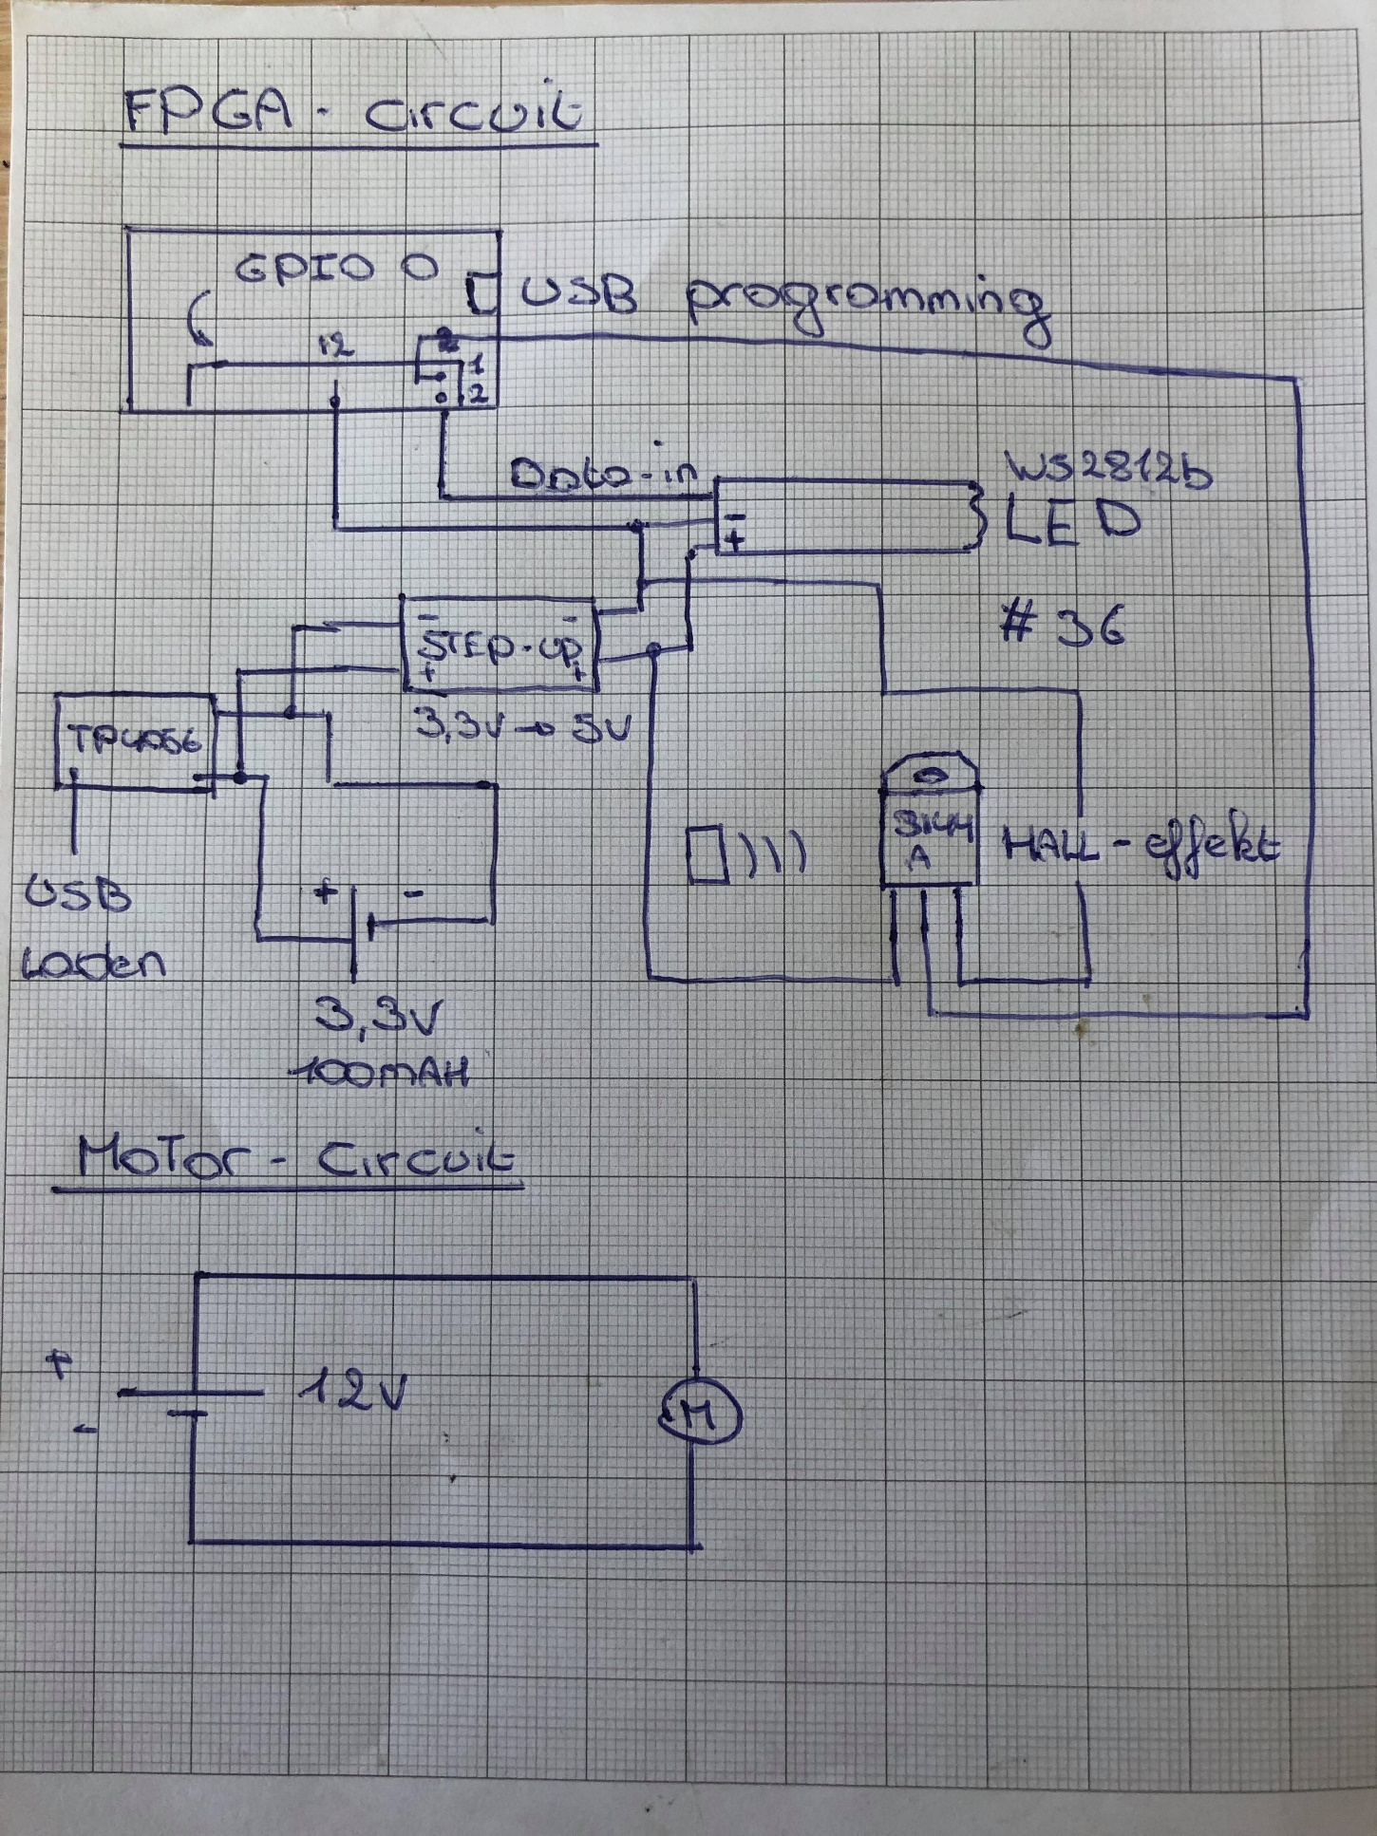
Electrical Schematic

Slide 11
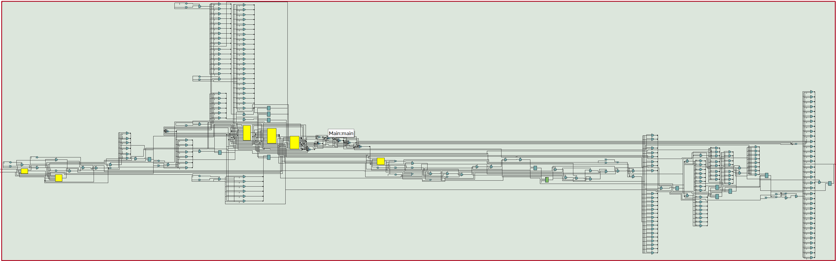
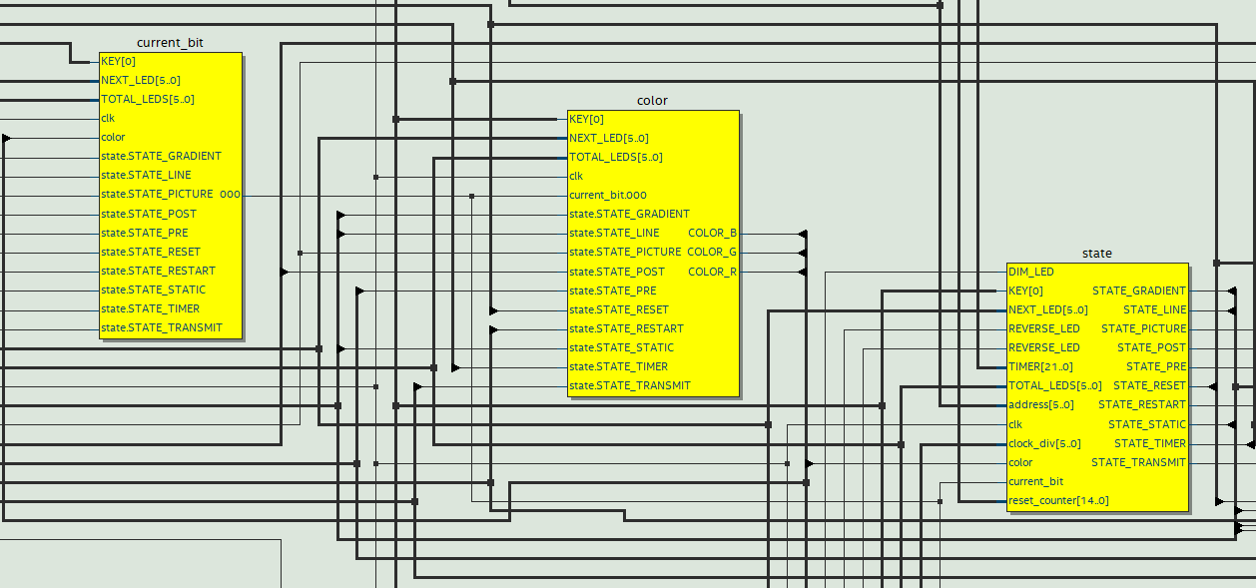
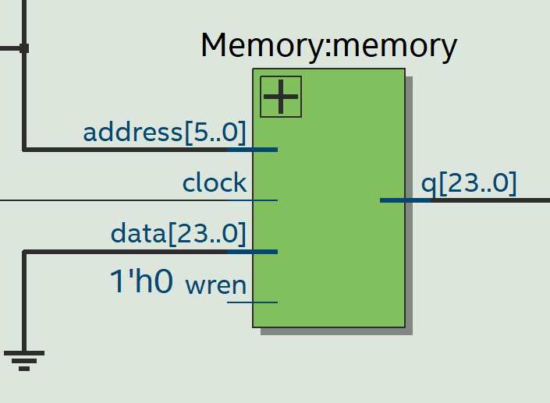
Block Diagram

Slide 12
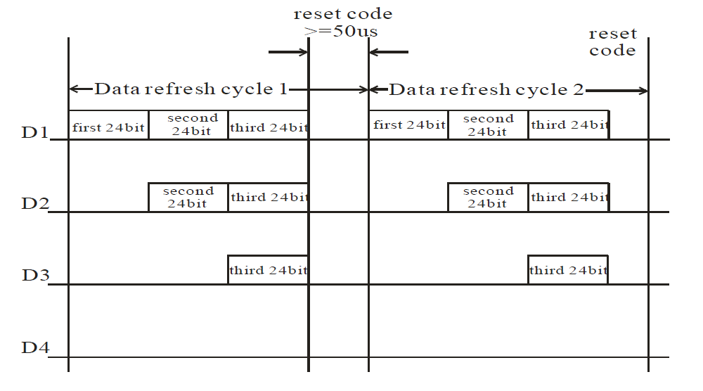
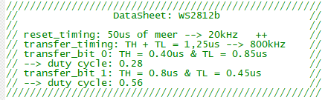
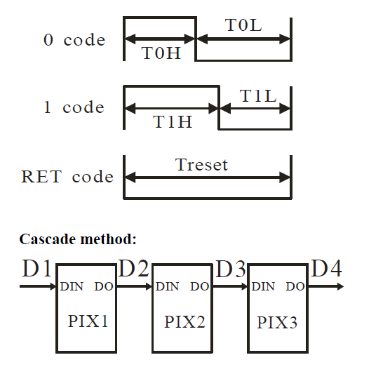
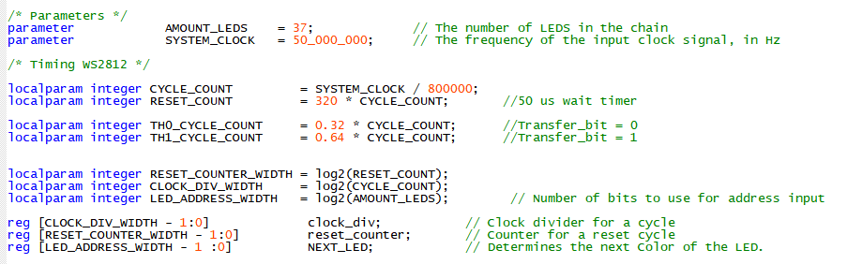

Actual Verilog Code
WS2812b LED use their own communication protocol, that depends on the duty-cycle of each LED. First order of business is to transform this protocol in Verilog code.
$$f=1/T$$

Slide 13
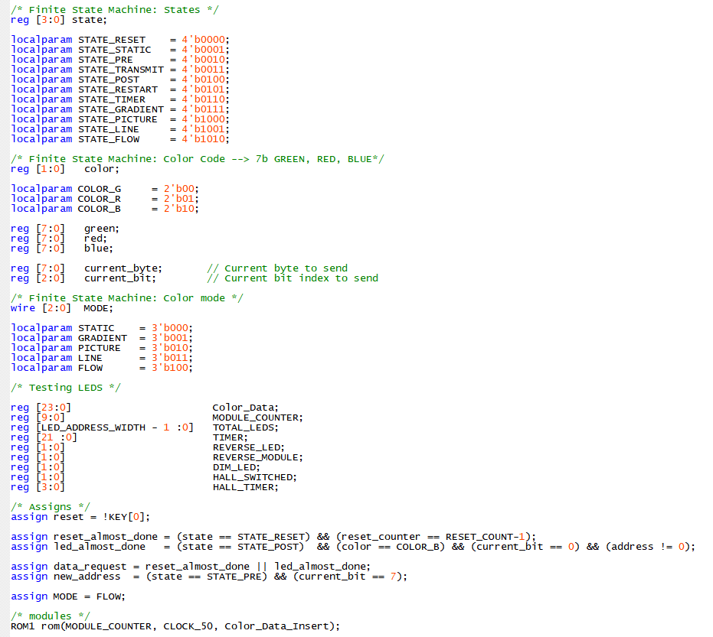
Actual Verilog Code

Slide 14
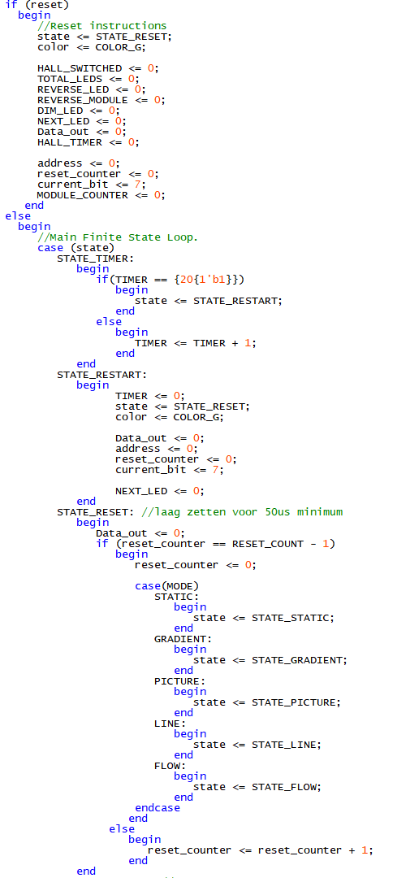
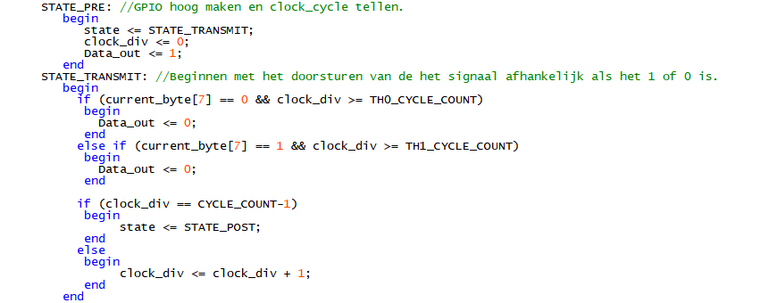
Actual Verilog Code

Slide 15
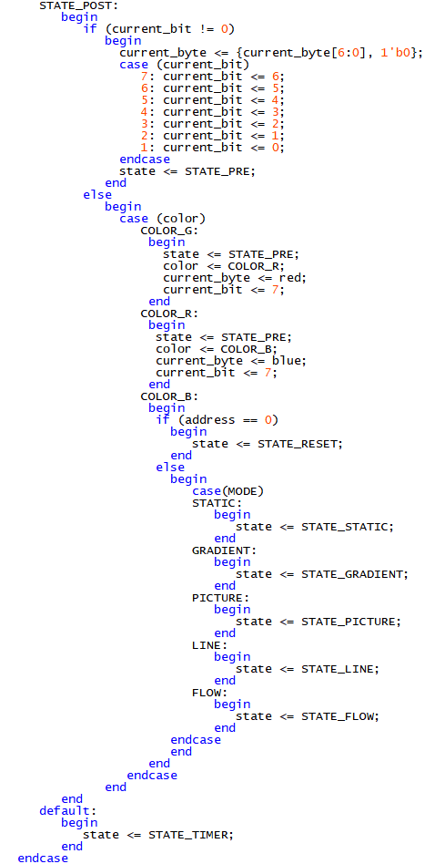
Actual Verilog Code

Slide 16
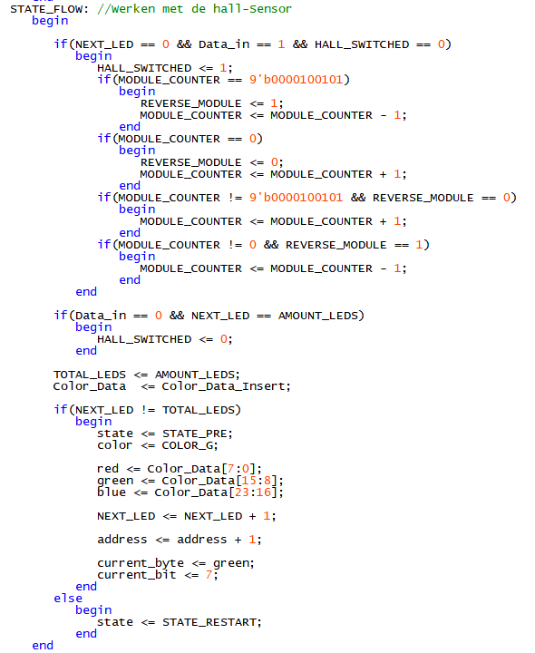
Actual Verilog Code (State examples)

Slide 17
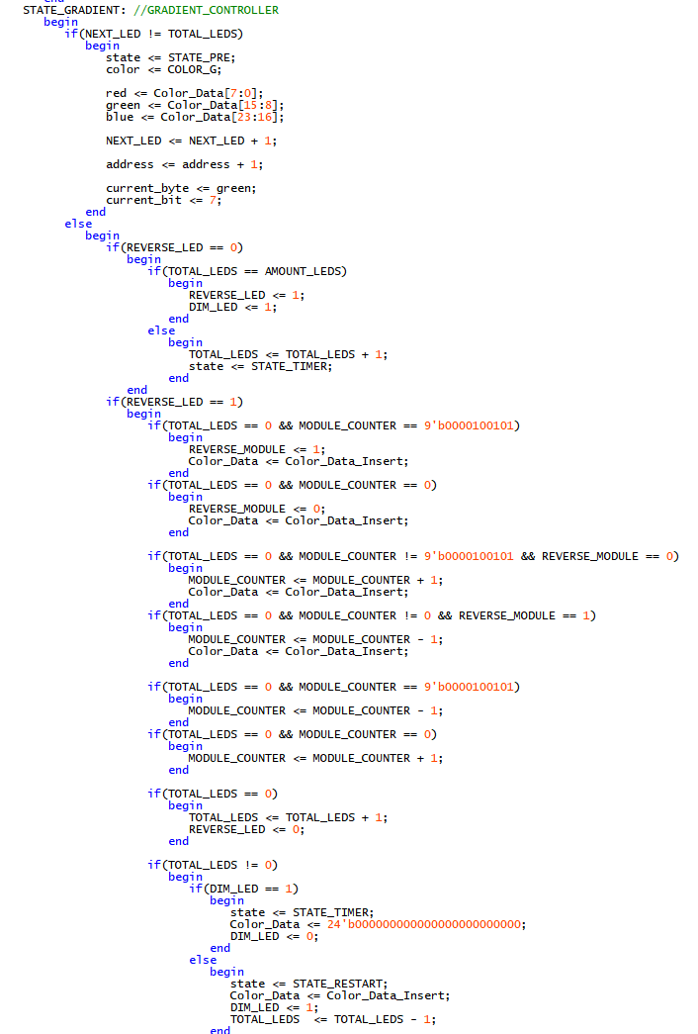
Actual Verilog Code (State examples)

Slide 18
Are there any questions left?
Jordi Jaspers

